Slide 1




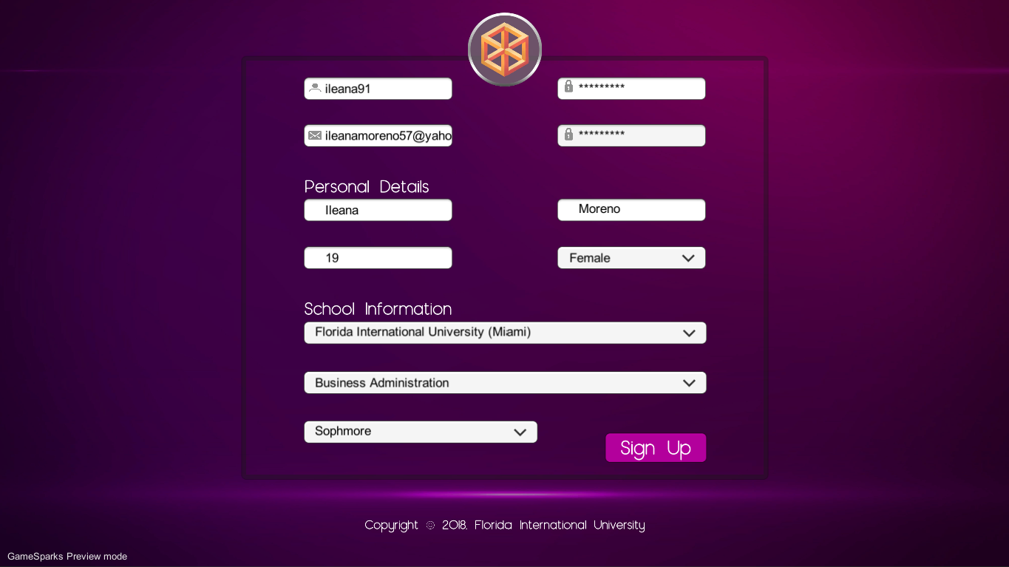
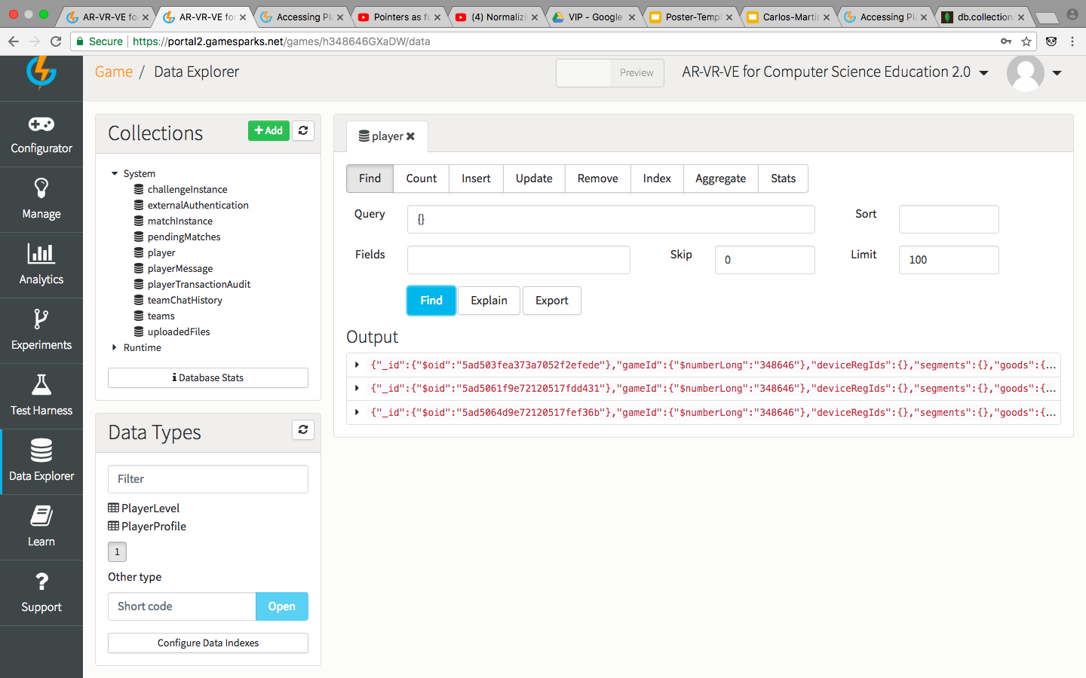
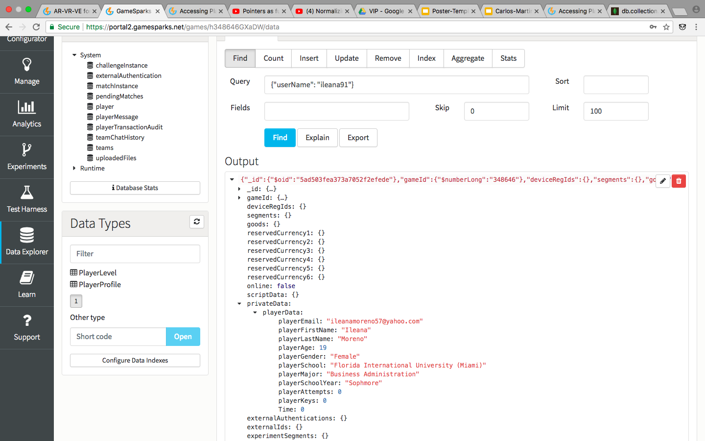
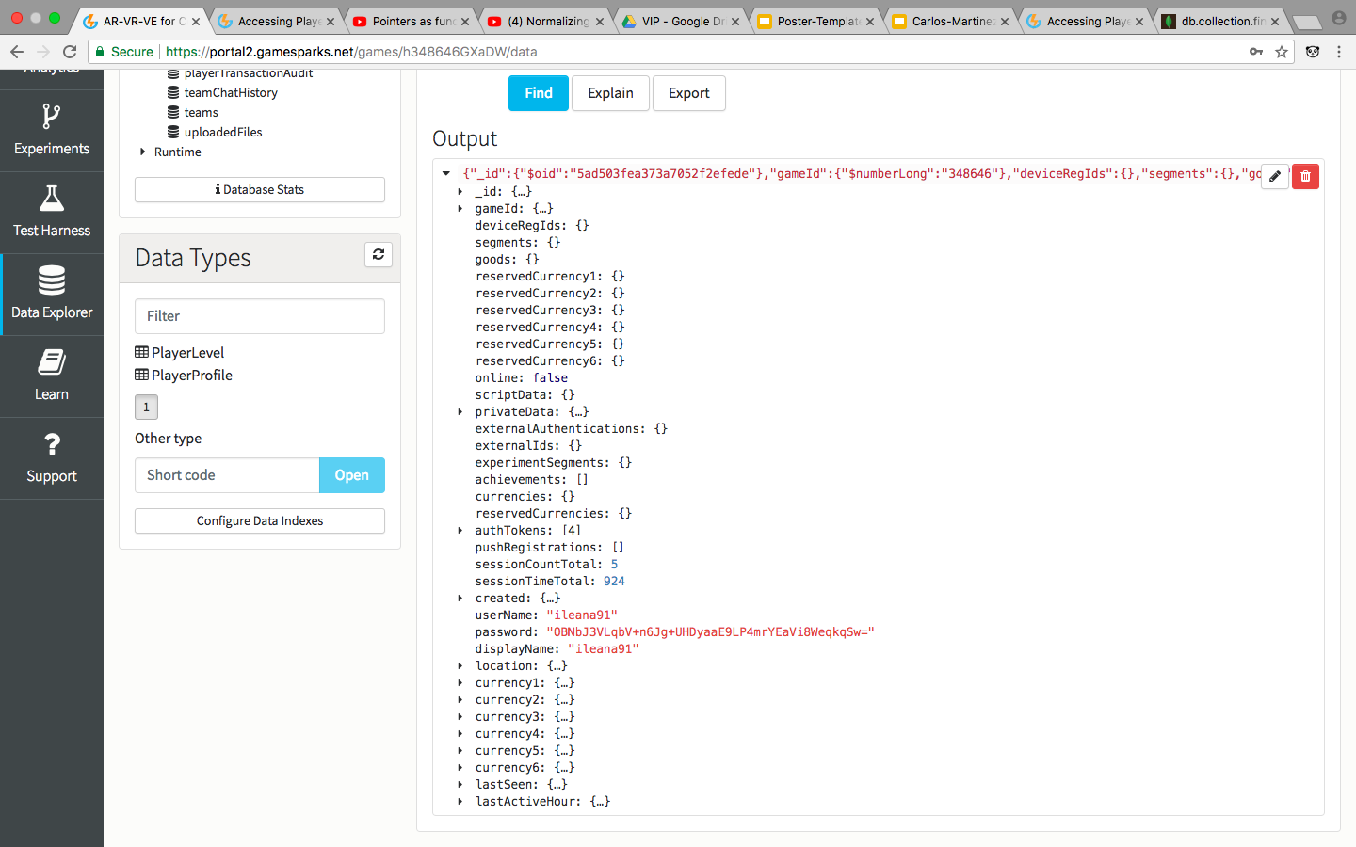





VIP IDS3917 2018, Spring
AR-VR-VE For Computer Science : A Desktop Game
Student: Fidel Hernandez, Florida International University
Mentor: Dr. Francisco R. Ortega, School of Computing and Information Sciences
Professor: Dr. Francisco R. Ortega & Masoud Sadjadi, Florida International University
Problem
There is a diversity problem in Computer Science due to the fact that programming is not seen as an enjoyable and accessible field.
Solution
Simple and enjoyable educational game that teaches players the fundamental principles of programming.
Current System
Done in VR
Screenshots
Requirements
User is able to register and log in to the game.
User is able to reset password if necessary.
Different basic and in-game player metrics are collected for further analysis
Users are able to save their progress before quitting the game
System Design and Implementation
OS: Windows and Mac
Unity Game Engine
C# and JavaScript for scripts
GameSparks framework for backend
Version Control: Github
Future Work
Implement a ranking system for users to see how they rank individually and grouped by major
Add a messaging system for users to communicate and share how they approached different problems
Summary
With the development of this game we will bridge the gender gap that exists in Computer Science by showing that programming can be enjoyable.
Acknowledgement
The material presented in this poster is based upon the work supported by Samira Tellez, Arelys Alvarez, Mairim Barrios and Carlos Martinez. I am thankful to the help that I received from my group members.
Notes:
1

